Slide 1
Lecture 4: Block Cipher Principles
An Introduction to Information Security
School of Big Data and Software Engineering, CQU
Fall, 2018

Slide 2
Quickly Review
Lecture 3
Fundamentals of Cryptography
Kerckhoff’s Principle
Confusion and Diffusion
Transposition and Substitution
Confusion and Diffusion
Block Cipher and Stream Cipher
Cryptanalysis
Ciphertext-Only Attack； Known-plaintext attack
Chosen-plaintext attack；Chosen-ciphertext attack
unconditional security; computational security; provable security…
Steganography

Slide 3
Quickly Review
Questions
If a cryptosystem has good performance to defense statistics attack/analysis, then the cryptosystem has property on:
Confusion?
Diffusion?

Slide 4

Outline
1. Product Cipher
2. The Feistel Cipher
3. Block Ciphers Design Principles

Slide 5
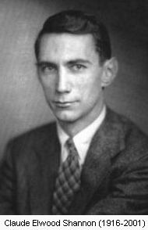
Lecture 4: Block Cipher Principles
1. Product Cipher
2…
3…
Shannon introduced the concept of a product (乘积) cipher.
A product cipher is a complex cipher combining:
Permutation(置换) or P-box
Substitution(代换) or S-box
and other components
XOR
Circular Shift
Swap
Split and Combine
…
Claude Elwood Shannon (April 30, 1916 – February 24, 2001), an American electronic engineer and mathematician, is known as "the father of information theory".

Slide 6
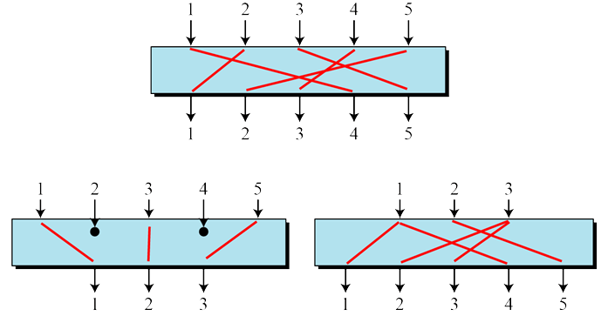
Lecture 4: Block Cipher Principles
1. Product Cipher
2…
3…
P-box
S-box
XOR
Circular Shift
Swap
Split/Combine
A P-box (permutation box) parallels the traditional transposition cipher for characters. It transposes (移动) bits.
A straight(直接的) P-box is invertible(可逆的), but compression and expansion P-boxes are not.
e.g.
Straight P-box
compression P-box
expansion P-box

Slide 7
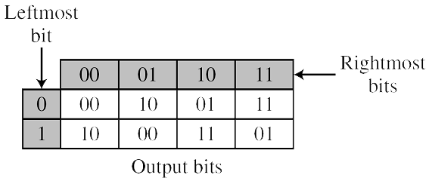
Lecture 4: Block Cipher Principles
1. Product Cipher
2…
3…
P-box
S-box
XOR
Circular Shift
Swap
Split/Combine
An S-box (substitution box) can be thought of as a miniature (微小的) substitution cipher.
An S-box is an m×n substitution unit, where m and n are not necessarily the same.
e.g.1
e.g.2
110 → 11
010 → 01

Slide 8
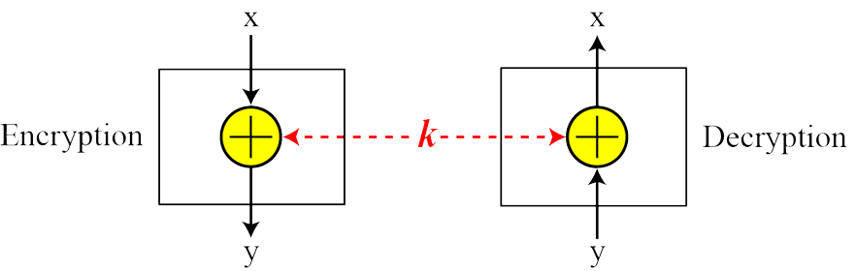
Lecture 4: Block Cipher Principles
1. Product Cipher
2…
3…
P-box
S-box
XOR
Circular Shift
Swap
Split/Combine
The exclusive-or operation is an important component in most block ciphers.
XOR | 0 | 1
0 | 0 | 1
1 | 1 | 0
+
A xor B xor B = ?
e.g.

Slide 9
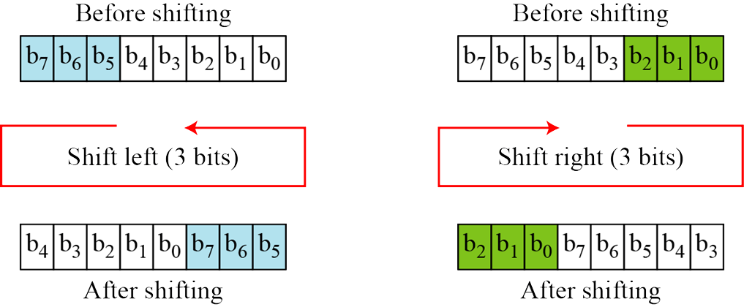
Lecture 4: Block Cipher Principles
1. Product Cipher
2…
3…
P-box
S-box
XOR
Circular Shift
Swap
Split/Combine
The circular shift operation is another component found in some modern block ciphers.
e.g.

Slide 10
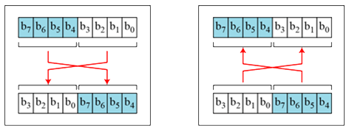
Lecture 4: Block Cipher Principles
1. Product Cipher
2…
3…
P-box
S-box
XOR
Circular Shift
Swap
Split/Combine
The swap operation is a special case of the circular shift operation where k = n/2.
e.g.

Slide 11
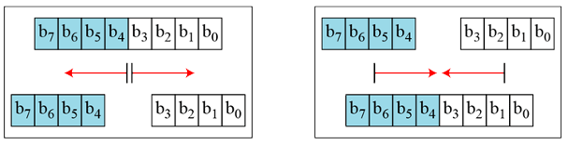
Lecture 4: Block Cipher Principles
1. Product Cipher
2…
3…
P-box
S-box
XOR
Circular Shift
Swap
Split/Combine
Two other operations found in some block ciphers are split and combine.
e.g.
Split
Combine

Slide 12
Lecture 4: Block Cipher Principles
1. Product Cipher
2…
3…
Product Cipher: a simple example
block1
block2
……
blockn
8 bit plain text
8 bit middle text
1
2
3
4
5
6
7
8
k₂
Round 1
key mixer
k₁
Round 2
S-box 1
S-box 2
S-box 3
S-box 4
Round Key Generator
P-box
K
8 bit middle text
8 bit cipher text

Slide 13
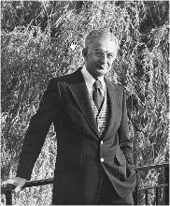
Lecture 4: Block Cipher Principles
1…
2. The Feistel Cipher
3…
Feistel cipher is a symmetric structure used in the construction of block ciphers
based on concept of invertible(可逆的) product cipher.
implements Shannon’s S-P net concept
partitions input block into two halves
process through multiple rounds which
based on round function of right half & subkey
then have permutation(置换) swapping halves
L_{i}
R_{i}
Horst Feistel 1915-1990
+
F
K_{i}
L_{i+1}
R_{i+1}
L_{i+1}
R_{i+1}

Slide 14
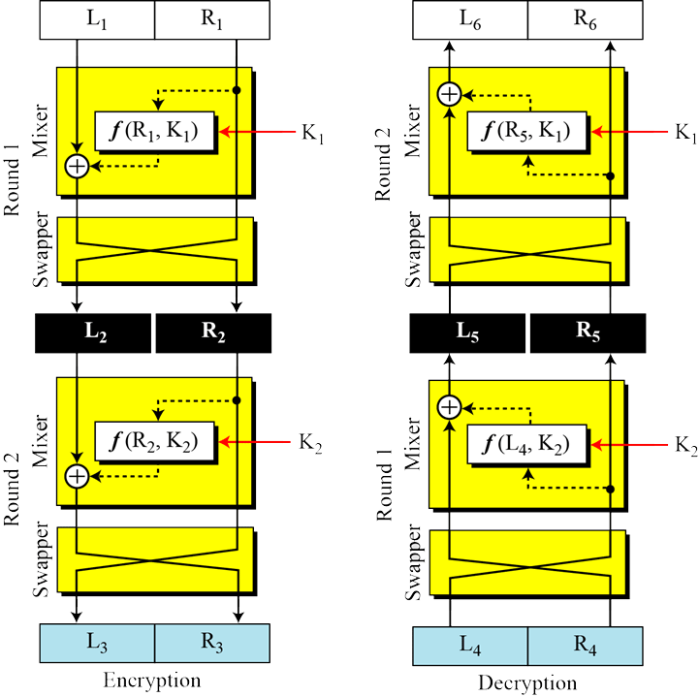
Lecture 4: Block Cipher Principles
1…
2. The Feistel Cipher
3…
Feistel Cipher: Properties
Block size
Key size
Number of rounds
Subkey generation
Round function
Fast software E/D
Ease of analysis

Slide 15
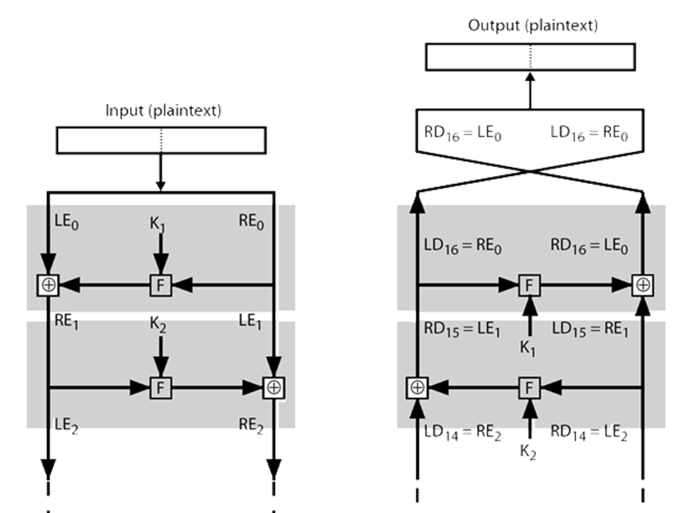
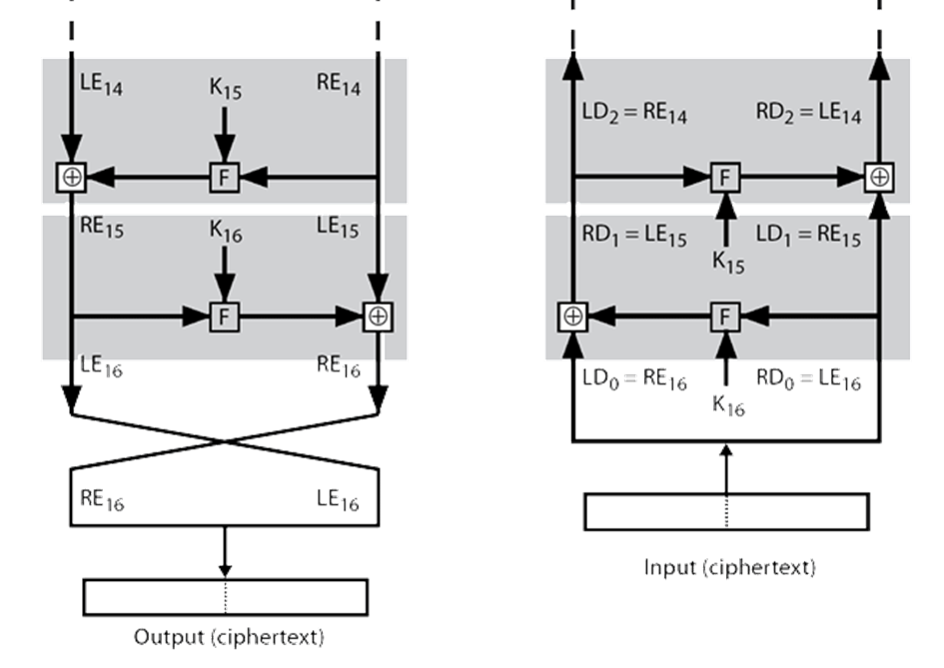
Lecture 4: Block Cipher Principles
1…
2. The Feistel Cipher
3…
Invertible: Decryption is the inverse of Encryption:

Slide 16
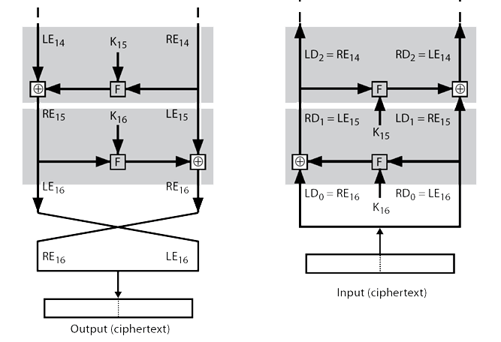
Lecture 4: Block Cipher Principles
1…
2. The Feistel Cipher
3…
Invertible: Decryption is the inverse of Encryption:
LE₁₆=RE₁₅
RE₁₆=LE₁₅⊕F(RE₁₅,K₁₆)
LD₁=RD₀=LE₁₆=RE₁₅
RD₁=LD₀ ⊕F(RD₀,K₁₆)
=RE₁₆⊕F(RE₁₅,K₁₆)
=LE₁₅⊕F(RE₁₅,K₁₆) ⊕F(RE₁₅,K₁₆)
=？
=LE₁₅
LD₁=RE₁₅
RD₁=LE₁₅
可否推导出？
A⊕B⊕B=？
LD_{i}=RE_{16-i}
RD_{i}=LE_{16-i}

Slide 17
Lecture 4: Block Cipher Principles
1…
2…
3. Block Ciphers Design Principles
basic principles still like Feistel’s in 1970’s
block size
key size
number of rounds:
more is better, exhaustive search best attack
function f:
provides “confusion”
Nonlinear(非线性)
Avalanche(雪崩) effect
have issues of how S-boxes are selected
key schedule
complex subkey creation, key avalanche

Slide 18
Lecture 4: Block Cipher Principles
Summary
Product Cipher
The Feistel Cipher
Block Ciphers Design Principles

Slide 19
An Introduction to Information Security
Thanks for your attention!
Q&A

